Slide 1
HR Portal

Slide 2
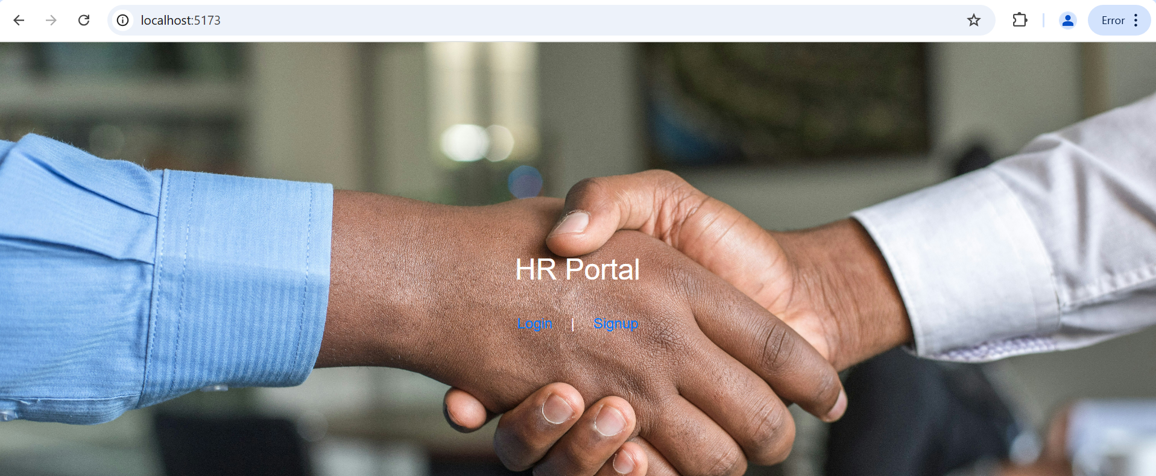

Slide 3
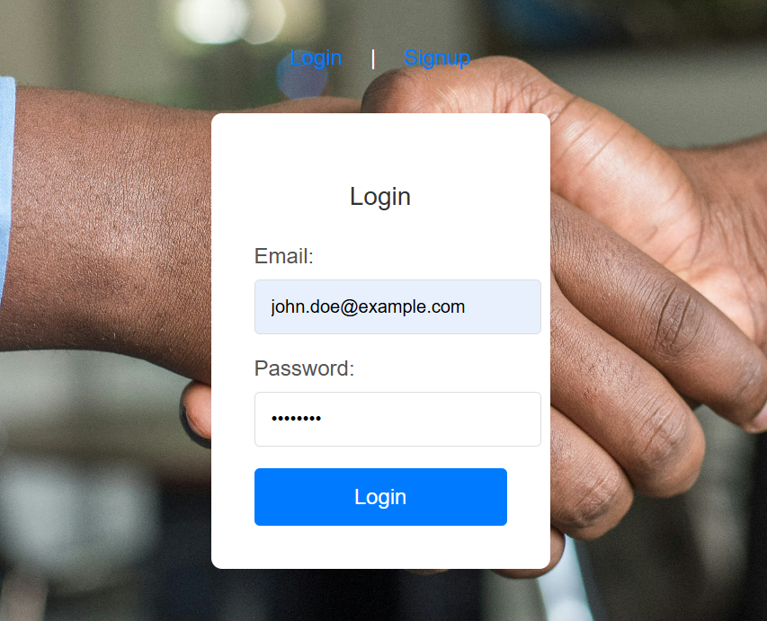
I clicked login

Slide 4
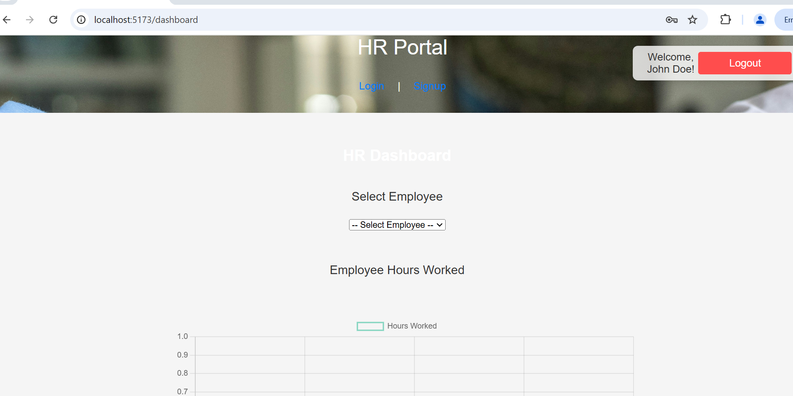
Dashboard of HR Manager

Slide 5
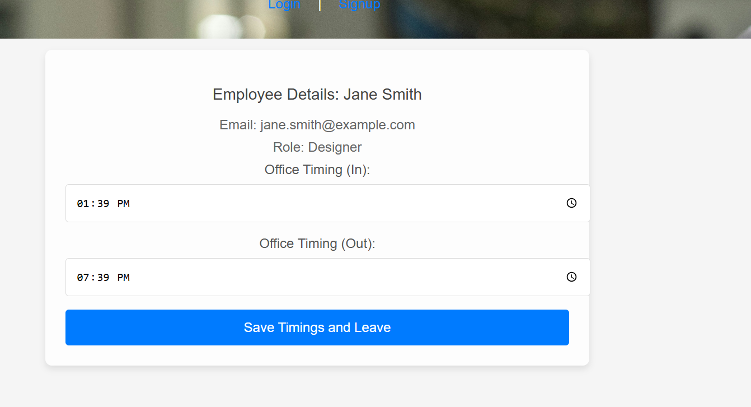
Employee should given check in and check out timing

Slide 6
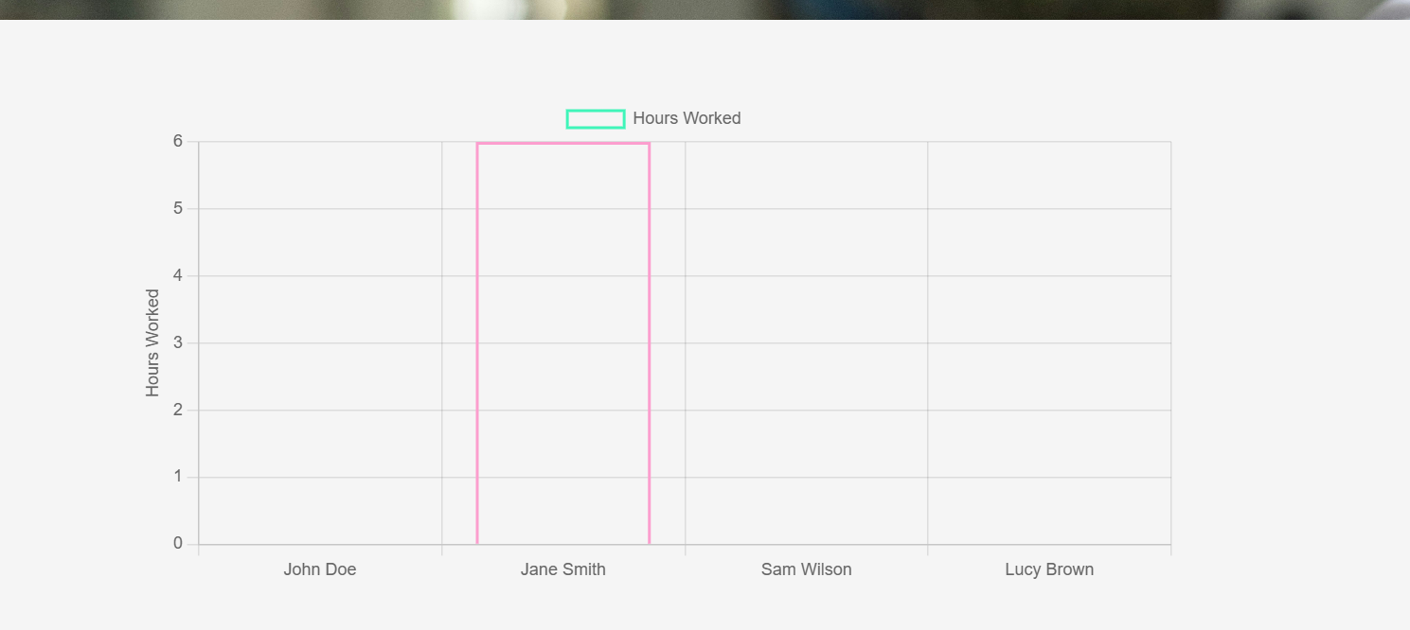
Once it done updated the HR can see the chart

